Slide 1

IS362 Final Project
Derek Becher
Fall 2018

Slide 2
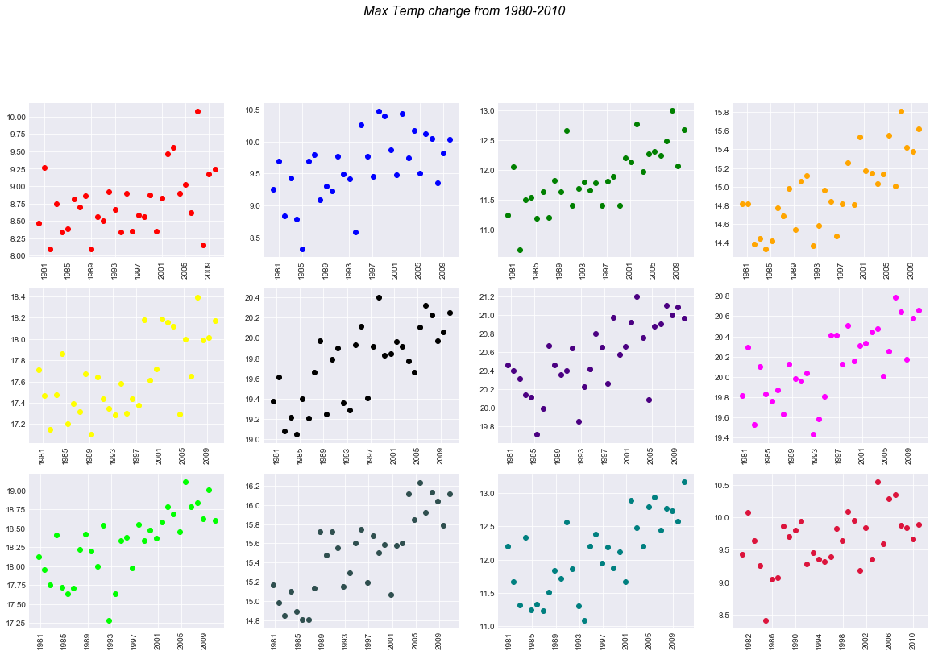
Notes:
The graph of temp maximum recorded temperature for each month. Each graph is a month starting with January in the top left and ending with December in the bottom right. It shows the maximum temperature for each month from 1980-2000. We can see that each month the maximum temperature has gotten warmer of the 30 year period..

Slide 3
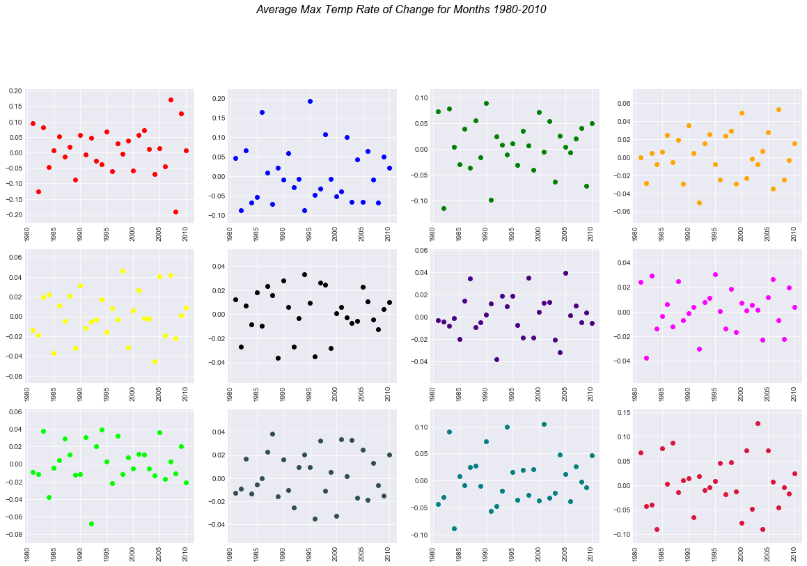
Notes:
There does not seem to be any trend in the rate of change for the maximum temperature. The rate the temperature has change for each month from year to year seems to fluctuate.

Slide 4
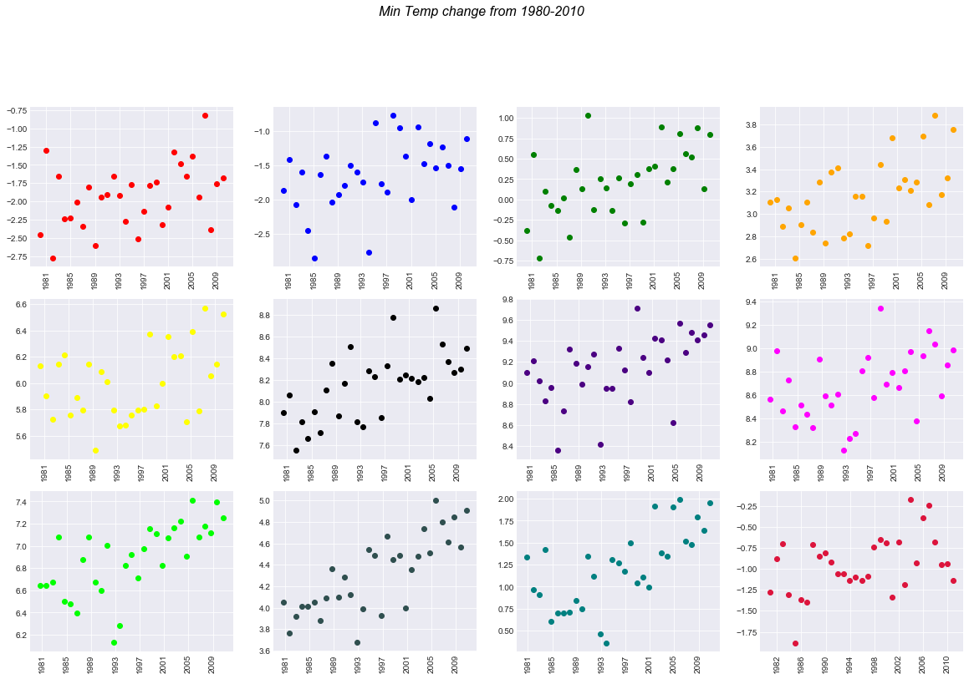
Notes:
The graph of temp minimum recorded temperature for each month. Each graph is a month starting with January in the top left and ending with December in the bottom right. It shows the minimum temperature for each month from 1980-2000. We can see that each month the minimum temperature has also gotten warmer over the 30 year period..

Slide 5
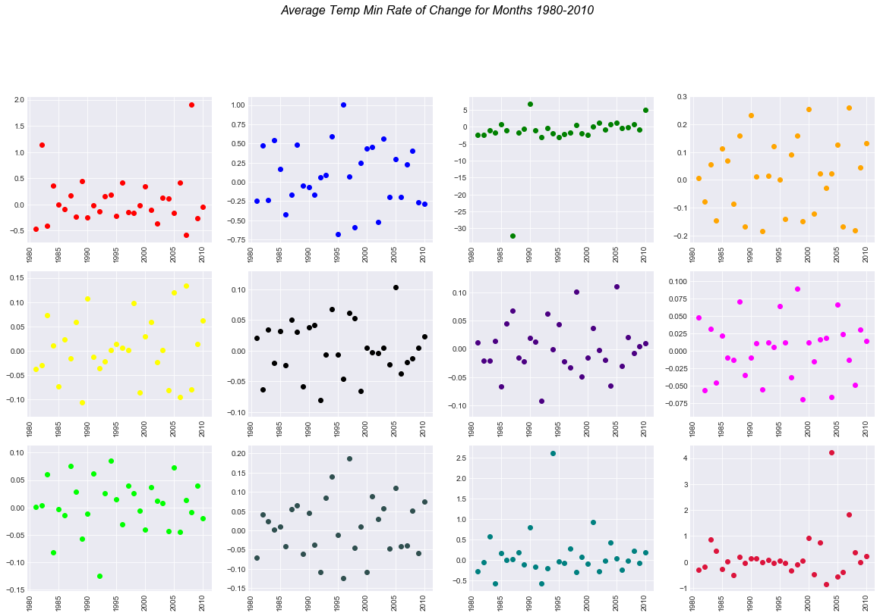
Notes:
There also does not seem to be any trend in the rate of change for the minimum temperature. The rate the temperature has change for each month from year to year seems to fluctuate.

Slide 6
Max. Temp.
Rate of Change
Min. Temp.
Rate of Change
1 - 0.005685 2 - 0.005162 3 - 0.005269 4 - 0.002061 5 - 0.001127 6 - 0.001653 7 - 0.000976 8 - 0.001540 9 - 0.001152 10 - 0.002222 11 - 0.003620 12 - 0.002984
1 - 0.068921 2 - 0.066550 3 - -1.525675 4 - 0.015027 5 - 0.004081 6 - 0.003310 7 - 0.002614 8 - 0.002454 9 - 0.004037 10 - 0.009113 11 - 0.110153 12 - 0.203626
Notes:
Here we can see that there does appear to be a slight trend in the rate of change over the entire 30 year period. I seems from the data that the winter months are experiencing a great rate of change than the summer months.

Slide 7
Biggest Challenge
The date when used as an index
Using the date for the axis of a graph

